Slide 1
WQD7010 Network & Security
Dr. Saaidal Razalli Bin Azzuhri
Dept. of Comp. System & Technology
Fac. of Science Comp & IT

Slide 2
Chapter 7
Wireless Network Security
Notes:
This chapter begins with a general overview of wireless security issues. We then focus
on the relatively new area of mobile device security, examining threats and countermeasures
for mobile devices used in the enterprise. Then, we look at the IEEE 802.11i
standard for wireless LAN security. This standard is part of IEEE 802.11, also referred
to as Wi-Fi. We begin the discussion with an overview of IEEE 802.11, and then we
look in some detail at IEEE 802.11i.

Slide 3
Wireless Security
Some of the key factors contributing to the higher security risk of wireless networks compared to wired networks include:
Channel
Wireless networking typically involves broadcast communications, which is far more susceptible to eavesdropping and jamming than wired networks
Wireless networks are also more vulnerable to active attacks that exploit vulnerabilities in communications protocols
Mobility
Wireless devices are far more portable and mobile than wired devices
This mobility results in a number of risks
Resources
Some wireless devices, such as smartphones and tablets, have sophisticated operating systems but limited memory and processing resources with which to counter threats, including denial of service and malware
Accessibility
Some wireless devices, such as sensors and robots, may be left unattended in remote and/or hostile locations
This greatly increases their vulnerability to physical attacks
Notes:
Wireless networks, and the wireless devices that use them, introduce a host of security
problems over and above those found in wired networks. Some of the key factors
contributing to the higher security risk of wireless networks compared to wired
networks include the following [MA10]:
• Channel: Wireless networking typically involves broadcast communications,
which is far more susceptible to eavesdropping and jamming than wired networks.
Wireless networks are also more vulnerable to active attacks that exploit
vulnerabilities in communications protocols.
• Mobility: Wireless devices are, in principal and usually in practice, far more
portable and mobile than wired devices. This mobility results in a number of
risks, described subsequently.
• Resources: Some wireless devices, such as smartphones and tablets, have sophisticated
operating systems but limited memory and processing resources
with which to counter threats, including denial of service and malware.
• Accessibility: Some wireless devices, such as sensors and robots, may be left
unattended in remote and/or hostile locations. This greatly increases their vulnerability
to physical attacks.

Slide 4
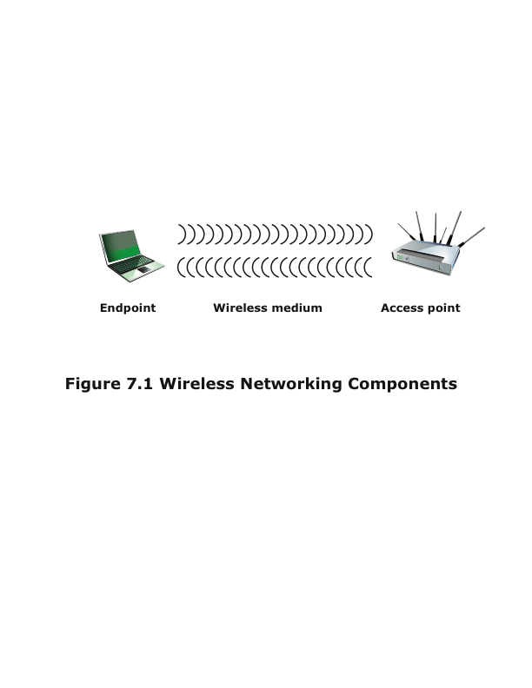
Wireless Networking Components
Consist of three components that provide point of attack
Endpoint, or wireless client can be a smart phone, laptop, any IoT, wireless sensor
Access point can be cell-towers, Wi-Fi hotspots
Transmission medium (carry radio waves)
Notes:
In simple terms, the wireless environment consists of three components that
provide point of attack (Figure 7.1). The wireless client can be a cell phone, a
Wi-Fi–enabled laptop or tablet, a wireless sensor, a Bluetooth device, and so on.
The wireless access point provides a connection to the network or service. Examples
of access points are cell towers, Wi-Fi hotspots, and wireless access points to wired
local or wide area networks. The transmission medium, which carries the radio
waves for data transfer, is also a source of vulnerability.

Slide 5
Wireless Network Threats
Accidental association
Company wireless LANs in close proximity may create overlapping transmission ranges
A user intending to connect to one LAN may unintentionally lock on to a wireless access point from a neighboring network
Malicious association
In this situation, a wireless device is configured to appear to be a legitimate access point, enabling the operator to steal passwords from legitimate users and then penetrate a wired network through a legitimate wireless access point
Ad hoc networks
These are peer-to-peer networks between wireless computers with no access point between them
Such networks can pose a security threat due to a lack of a central point of control
Nontraditional networks
Personal network Bluetooth devices, barcode readers, and handheld PDAs pose a security risk in terms of both eavesdropping and spoofing
Identity theft (MAC spoofing)
This occurs when an attacker is able to eavesdrop on network traffic and identify the MAC address of a computer with network privileges
Man-in-the-middle attacks
This attack involves persuading a user and an access point to believe that they are talking to each other when in fact the communication is going through an intermediate attacking device
Wireless networks are particularly vulnerable to such attacks
Denial of service (DoS)
This attack occurs when an attacker continually bombards a wireless access point or some other accessible wireless port with various protocol messages designed to consume system resources
The wireless environment lends itself to this type of attack because it is so easy for the attacker to direct multiple wireless messages at the target
Network injection
This attack targets wireless access points that are exposed to nonfiltered network traffic, such as routing protocol messages or network management messages
Notes:
[CHOI08] lists the following security threats to wireless networks:
• Accidental association: Company wireless LANs or wireless access points to
wired LANs in close proximity (e.g., in the same or neighboring buildings)
may create overlapping transmission ranges. A user intending to connect to
one LAN may unintentionally lock on to a wireless access point from a neighboring
network. Although the security breach is accidental, it nevertheless exposes
resources of one LAN to the accidental user.
• Malicious association: In this situation, a wireless device is configured to appear
to be a legitimate access point, enabling the operator to steal passwords
from legitimate users and then penetrate a wired network through a legitimate
wireless access point.
• Ad hoc networks: These are peer-to-peer networks between wireless computers
with no access point between them. Such networks can pose a security
threat due to a lack of a central point of control.
• Nontraditional networks: Nontraditional networks and links, such as personal
network Bluetooth devices, barcode readers, and handheld PDAs, pose a security
risk in terms of both eavesdropping and spoofing.
• Identity theft (MAC spoofing): This occurs when an attacker is able to eavesdrop
on network traffic and identify the MAC address of a computer with
network privileges.
• Man-in-the middle attacks: This type of attack is described in Chapter 3 in
the context of the Diffie-Hellman key exchange protocol. In a broader sense,
this attack involves persuading a user and an access point to believe that they
are talking to each other when in fact the communication is going through an
intermediate attacking device. Wireless networks are particularly vulnerable
to such attacks.
• Denial of service (DoS): This type of attack is discussed in detail in Chapter 10.
In the context of a wireless network, a DoS attack occurs when an attacker
continually bombards a wireless access point or some other accessible wireless
port with various protocol messages designed to consume system resources.
The wireless environment lends itself to this type of attack, because it is so
easy for the attacker to direct multiple wireless messages at the target.
• Network injection: A network injection attack targets wireless access points
that are exposed to nonfiltered network traffic, such as routing protocol messages
or network management messages. An example of such an attack is
one in which bogus reconfiguration commands are used to affect routers and
switches to degrade network performance.

Slide 6
Securing Wireless Transmissions
The principal threats to wireless transmission are eavesdropping, altering or inserting messages, and disruption
To deal with eavesdropping, two types of countermeasures are appropriate:
Signal-hiding techniques
Turn off SSID broadcasting by wireless access points
Assign cryptic names to SSIDs
Reduce signal strength to the lowest level that still provides requisite coverage
Locate wireless access points in the interior of the building, away from windows and exterior walls
Encryption
Is effective against eavesdropping to the extent that the encryption keys are secured
It's extremely easy to find the ID for a "hidden" network-all you have to do is use a utility like inSSIDer, NetStumbler, or Kismet to scan the network for a short while to show all of the current networks out there. It's really that simple, and there's plenty of other tools that do the same job.
Notes:
The principal threats to wireless transmission
are eavesdropping, altering or inserting messages, and disruption. To deal with
eavesdropping, two types of countermeasures are appropriate:
• Signal-hiding techniques: Organizations can take a number of measures to
make it more difficult for an attacker to locate their wireless access points,
including turning off service set identifier (SSID) broadcasting by wireless access
points; assigning cryptic names to SSIDs; reducing signal strength to the
lowest level that still provides requisite coverage; and locating wireless access
points in the interior of the building, away from windows and exterior walls.
Greater security can be achieved by the use of directional antennas and of
signal-shielding techniques.
• Encryption: Encryption of all wireless transmission is effective against eavesdropping
to the extent that the encryption keys are secured.
The use of encryption and authentication protocols is the standard method of
countering attempts to alter or insert transmissions.
The methods discussed in Chapter 10 for dealing with DoS apply to wireless
transmissions. Organizations can also reduce the risk of unintentional DoS attacks.
Site surveys can detect the existence of other devices using the same frequency
range, to help determine where to locate wireless access points. Signal strengths can
be adjusted and shielding used in an attempt to isolate a wireless environment from
competing nearby transmissions.

Slide 7
Securing Wireless Access Points
The main threat involving wireless access points is unauthorized access to the network
The principal approach for preventing such access is the IEEE 802.1x standard for port-based network access control
The standard provides an authentication mechanism for devices wishing to attach to a LAN or wireless network
The use of 802.1x can prevent rogue access points and other unauthorized devices from becoming insecure backdoors
Notes:
The main threat involving wireless access
points is unauthorized access to the network. The principal approach for preventing
such access is the IEEE 802.1X standard for port-based network access control. The
standard provides an authentication mechanism for devices wishing to attach to a
LAN or wireless network. The use of 802.1X can prevent rogue access points and
other unauthorized devices from becoming insecure backdoors.
Section 5.3 provides an introduction to 802.1X.

Slide 8
Securing Wireless Networks

Slide 9
Mobile Device Security
Mobile devices have become an essential element for organizations as part of the overall network infrastructure
Prior to the widespread use of smartphones, network security was based upon clearly defined perimeters that separated trusted internal networks from the untrusted Internet
Due to massive changes, an organization’s networks must now accommodate:
Growing use of new devices
Cloud-based applications
De-perimeterization
External business requirements
Notes:
Prior to the widespread use of smartphones, the dominant paradigm for computer
and network security in organizations was as follows. Corporate IT was tightly controlled.
User devices were typically limited to Windows PCs. Business applications
were controlled by IT and either run locally on endpoints or on physical servers
in data centers. Network security was based upon clearly defined perimeters that
separated trusted internal networks from the untrusted Internet. Today, there have
been massive changes in each of these assumptions. An organization’s networks
must accommodate the following:
• Growing use of new devices: Organizations are experiencing significant growth
in employee use of mobile devices. In many cases, employees are allowed to
use a combination of endpoint devices as part of their day-to-day activities.
• Cloud-based applications: Applications no longer run solely on physical
servers in corporate data centers. Quite the opposite, applications can run
anywhere—on traditional physical servers, on mobile virtual servers, or in the
cloud. Additionally, end users can now take advantage of a wide variety of
cloud-based applications and IT services for personal and professional use.
Facebook can be used for an employee’s personal profiles or as a component
of a corporate marketing campaign. Employees depend upon Skype to speak
with friends abroad or for legitimate business video conferencing. Dropbox
and Box can be used to distribute documents between corporate and personal
devices for mobility and user productivity.
• De-perimeterization: Given new device proliferation, application mobility,
and cloud-based consumer and corporate services, the notion of a static network
perimeter is all but gone. Now there are a multitude of network perimeters
around devices, applications, users, and data. These perimeters have also
become quite dynamic as they must adapt to various environmental conditions
such as user role, device type, server virtualization mobility, network location,
and time-of-day.
• External business requirements: The enterprise must also provide guests,
third-party contractors, and business partners network access using various
devices from a multitude of locations.
The central element in all of these changes is the mobile computing device.
Mobile devices have become an essential element for organizations as part of the
overall network infrastructure. Mobile devices such as smartphones, tablets, and
memory sticks provide increased convenience for individuals as well as the potential
for increased productivity in the workplace. Because of their widespread use and
unique characteristics, security for mobile devices is a pressing and complex issue.
In essence, an organization needs to implement a security policy through a combination
of security features built into the mobile devices and additional security controls
provided by network components that regulate the use of the mobile devices.

Slide 10
Mobile Device Security

Slide 11
Mobile Device Security

Slide 12
Mobile Device Security

Slide 13
Mobile Device Security

Slide 14
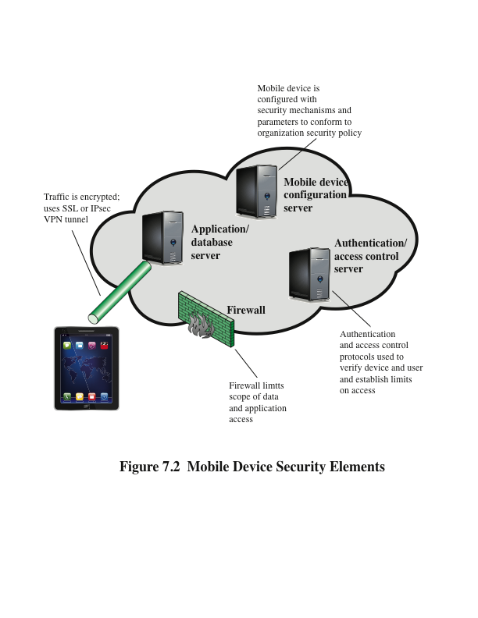
Mobile Devices Security Strategy
Fall into 3 categories:
Device Security
Traffic Security
Barrier Security
Mobile device Security Elements
Notes:
With the threats listed in the preceding discussion in mind, we outline the principal
elements of a mobile device security strategy. They fall into three categories: device
security, client/server traffic security, and barrier security (Figure 7.2).
Device Security
A number of organizations will supply mobile devices for employee
use and preconfigure those devices to conform to the enterprise security policy.
However, many organizations will find it convenient or even necessary to adopt a bring-your-
own-device (BYOD) policy that allows the personal mobile devices of employees
to have access to corporate resources. IT managers should be able to inspect each
device before allowing network access. IT will want to establish configuration guidelines
for operating systems and applications. For example, “rooted” or “jail-broken”
devices are not permitted on the network, and mobile devices cannot store corporate
contacts on local storage. Whether a device is owned by the organization or BYOD, the
organization should configure the device with security controls, including the following:
• Enable auto-lock, which causes the device to lock if it has not been used for a
given amount of time, requiring the user to re-enter a four-digit PIN or a password
to re-activate the device.
• Enable password or PIN protection. The PIN or password is needed to unlock
the device. In addition, it can be configured so that e-mail and other data on
the device are encrypted using the PIN or password and can only be retrieved
with the PIN or password.
• Avoid using auto-complete features that remember user names or passwords.
• Enable remote wipe.
• Ensure that SSL protection is enabled, if available.
• Make sure that software, including operating systems and applications, is up
to date.
• Install antivirus software as it becomes available.
• Either sensitive data should be prohibited from storage on the mobile device
or it should be encrypted.
• IT staff should also have the ability to remotely access devices, wipe the device
of all data, and then disable the device in the event of loss or theft.
• The organization may prohibit all installation of third-party applications,
implement white-listing to prohibit installation of all unapproved applications,
or implement a secure sandbox that isolates the organization’s data and
applications from all other data and applications on the mobile device. Any
application that is on an approved list should be accompanied by a digital
signature and a public-key certificate from an approved authority.
• The organization can implement and enforce restrictions on what devices can
synchronize and on the use of cloud-based storage.
• To deal with the threat of untrusted content, security responses can include
training of personnel on the risks inherent in untrusted content and disabling
camera use on corporate mobile devices.
• To counter the threat of malicious use of location services, the security policy
can dictate that such service is disabled on all mobile devices.
Traffic Security
Traffic security is based on the usual mechanisms for encryption
and authentication. All traffic should be encrypted and travel by secure means, such
as SSL or IPv6. Virtual private networks (VPNs) can be configured so that all traffic
between the mobile device and the organization’s network is via a VPN.
A strong authentication protocol should be used to limit the access from the
device to the resources of the organization. Often, a mobile device has a single
device-specific authenticator, because it is assumed that the device has only one
user. A preferable strategy is to have a two-layer authentication mechanism, which
involves authenticating the device and then authenticating the user of the device.
Barrier Security
The organization should have security mechanisms to protect the
network from unauthorized access. The security strategy can also include firewall policies
specific to mobile device traffic. Firewall policies can limit the scope of data and
application access for all mobile devices. Similarly, intrusion detection and intrusion
prevention systems can be configured to have tighter rules for mobile device traffic.

Slide 15
Device Security
Many organizations will find it convenient or even necessary to adopt a bring-your-
own-device (BYOD) policy that allows the personal mobile devices of employees
to have access to corporate resources. IT will want to establish configuration guidelines
for operating systems and applications. For example, “rooted” or “jail-broken”
devices are not permitted on the network, and mobile devices cannot store corporate
contacts on local storage. Device should be configure with:
Enable auto-lock
Enable password or PIN protection
Avoid using auto-complete features for username/password
Enable remote-wipe
Secure Sockets Layer (SSL) protection if available
OS, software, apps are up to date
Install anti virus
Sensitive data prohibition
IT staff can remote access the device
Prohibit 3rd party installation
Implement and enforce restriction
Active r4sponse on untrusted content
Location service must be controlled
Notes:
With the threats listed in the preceding discussion in mind, we outline the principal
elements of a mobile device security strategy. They fall into three categories: device
security, client/server traffic security, and barrier security (Figure 7.2).
Device Security
A number of organizations will supply mobile devices for employee
use and preconfigure those devices to conform to the enterprise security policy.
However, many organizations will find it convenient or even necessary to adopt a bring-your-
own-device (BYOD) policy that allows the personal mobile devices of employees
to have access to corporate resources. IT managers should be able to inspect each
device before allowing network access. IT will want to establish configuration guidelines
for operating systems and applications. For example, “rooted” or “jail-broken”
devices are not permitted on the network, and mobile devices cannot store corporate
contacts on local storage. Whether a device is owned by the organization or BYOD, the
organization should configure the device with security controls, including the following:
• Enable auto-lock, which causes the device to lock if it has not been used for a
given amount of time, requiring the user to re-enter a four-digit PIN or a password
to re-activate the device.
• Enable password or PIN protection. The PIN or password is needed to unlock
the device. In addition, it can be configured so that e-mail and other data on
the device are encrypted using the PIN or password and can only be retrieved
with the PIN or password.
• Avoid using auto-complete features that remember user names or passwords.
• Enable remote wipe.
• Ensure that SSL protection is enabled, if available.
• Make sure that software, including operating systems and applications, is up
to date.
• Install antivirus software as it becomes available.
• Either sensitive data should be prohibited from storage on the mobile device
or it should be encrypted.
• IT staff should also have the ability to remotely access devices, wipe the device
of all data, and then disable the device in the event of loss or theft.
• The organization may prohibit all installation of third-party applications,
implement white-listing to prohibit installation of all unapproved applications,
or implement a secure sandbox that isolates the organization’s data and
applications from all other data and applications on the mobile device. Any
application that is on an approved list should be accompanied by a digital
signature and a public-key certificate from an approved authority.
• The organization can implement and enforce restrictions on what devices can
synchronize and on the use of cloud-based storage.
• To deal with the threat of untrusted content, security responses can include
training of personnel on the risks inherent in untrusted content and disabling
camera use on corporate mobile devices.
• To counter the threat of malicious use of location services, the security policy
can dictate that such service is disabled on all mobile devices.
Traffic Security
Traffic security is based on the usual mechanisms for encryption
and authentication. All traffic should be encrypted and travel by secure means, such
as SSL or IPv6. Virtual private networks (VPNs) can be configured so that all traffic
between the mobile device and the organization’s network is via a VPN.
A strong authentication protocol should be used to limit the access from the
device to the resources of the organization. Often, a mobile device has a single
device-specific authenticator, because it is assumed that the device has only one
user. A preferable strategy is to have a two-layer authentication mechanism, which
involves authenticating the device and then authenticating the user of the device.
Barrier Security
The organization should have security mechanisms to protect the
network from unauthorized access. The security strategy can also include firewall policies
specific to mobile device traffic. Firewall policies can limit the scope of data and
application access for all mobile devices. Similarly, intrusion detection and intrusion
prevention systems can be configured to have tighter rules for mobile device traffic.

Slide 16
Traffic Security
Traffic security is based on the usual mechanisms for encryption
and authentication. All traffic should be encrypted and travel by secure means, such as SSL or IPv6. Virtual private networks (VPNs) can be configured so that all traffic between the mobile device and the organization’s network is via a VPN.
A strong authentication protocol should be used to limit the access from the
device to the resources of the organization. Often, a mobile device has a single
device-specific authenticator, because it is assumed that the device has only one
user. A preferable strategy is to have a two-layer authentication mechanism, which
involves authenticating the device and then authenticating the user of the device.
Notes:
With the threats listed in the preceding discussion in mind, we outline the principal
elements of a mobile device security strategy. They fall into three categories: device
security, client/server traffic security, and barrier security (Figure 7.2).
Device Security
A number of organizations will supply mobile devices for employee
use and preconfigure those devices to conform to the enterprise security policy.
However, many organizations will find it convenient or even necessary to adopt a bring-your-
own-device (BYOD) policy that allows the personal mobile devices of employees
to have access to corporate resources. IT managers should be able to inspect each
device before allowing network access. IT will want to establish configuration guidelines
for operating systems and applications. For example, “rooted” or “jail-broken”
devices are not permitted on the network, and mobile devices cannot store corporate
contacts on local storage. Whether a device is owned by the organization or BYOD, the
organization should configure the device with security controls, including the following:
• Enable auto-lock, which causes the device to lock if it has not been used for a
given amount of time, requiring the user to re-enter a four-digit PIN or a password
to re-activate the device.
• Enable password or PIN protection. The PIN or password is needed to unlock
the device. In addition, it can be configured so that e-mail and other data on
the device are encrypted using the PIN or password and can only be retrieved
with the PIN or password.
• Avoid using auto-complete features that remember user names or passwords.
• Enable remote wipe.
• Ensure that SSL protection is enabled, if available.
• Make sure that software, including operating systems and applications, is up
to date.
• Install antivirus software as it becomes available.
• Either sensitive data should be prohibited from storage on the mobile device
or it should be encrypted.
• IT staff should also have the ability to remotely access devices, wipe the device
of all data, and then disable the device in the event of loss or theft.
• The organization may prohibit all installation of third-party applications,
implement white-listing to prohibit installation of all unapproved applications,
or implement a secure sandbox that isolates the organization’s data and
applications from all other data and applications on the mobile device. Any
application that is on an approved list should be accompanied by a digital
signature and a public-key certificate from an approved authority.
• The organization can implement and enforce restrictions on what devices can
synchronize and on the use of cloud-based storage.
• To deal with the threat of untrusted content, security responses can include
training of personnel on the risks inherent in untrusted content and disabling
camera use on corporate mobile devices.
• To counter the threat of malicious use of location services, the security policy
can dictate that such service is disabled on all mobile devices.
Traffic Security
Traffic security is based on the usual mechanisms for encryption
and authentication. All traffic should be encrypted and travel by secure means, such
as SSL or IPv6. Virtual private networks (VPNs) can be configured so that all traffic
between the mobile device and the organization’s network is via a VPN.
A strong authentication protocol should be used to limit the access from the
device to the resources of the organization. Often, a mobile device has a single
device-specific authenticator, because it is assumed that the device has only one
user. A preferable strategy is to have a two-layer authentication mechanism, which
involves authenticating the device and then authenticating the user of the device.
Barrier Security
The organization should have security mechanisms to protect the
network from unauthorized access. The security strategy can also include firewall policies
specific to mobile device traffic. Firewall policies can limit the scope of data and
application access for all mobile devices. Similarly, intrusion detection and intrusion
prevention systems can be configured to have tighter rules for mobile device traffic.

Slide 17
Barrier Security
The organization should have security mechanisms to protect the
network from unauthorized access. The security strategy can also include firewall policies specific to mobile device traffic. Firewall policies can limit the scope of data and
application access for all mobile devices. Similarly, intrusion detection and intrusion prevention systems can be configured to have tighter rules for mobile device traffic.
.
Notes:
With the threats listed in the preceding discussion in mind, we outline the principal
elements of a mobile device security strategy. They fall into three categories: device
security, client/server traffic security, and barrier security (Figure 7.2).
Device Security
A number of organizations will supply mobile devices for employee
use and preconfigure those devices to conform to the enterprise security policy.
However, many organizations will find it convenient or even necessary to adopt a bring-your-
own-device (BYOD) policy that allows the personal mobile devices of employees
to have access to corporate resources. IT managers should be able to inspect each
device before allowing network access. IT will want to establish configuration guidelines
for operating systems and applications. For example, “rooted” or “jail-broken”
devices are not permitted on the network, and mobile devices cannot store corporate
contacts on local storage. Whether a device is owned by the organization or BYOD, the
organization should configure the device with security controls, including the following:
• Enable auto-lock, which causes the device to lock if it has not been used for a
given amount of time, requiring the user to re-enter a four-digit PIN or a password
to re-activate the device.
• Enable password or PIN protection. The PIN or password is needed to unlock
the device. In addition, it can be configured so that e-mail and other data on
the device are encrypted using the PIN or password and can only be retrieved
with the PIN or password.
• Avoid using auto-complete features that remember user names or passwords.
• Enable remote wipe.
• Ensure that SSL protection is enabled, if available.
• Make sure that software, including operating systems and applications, is up
to date.
• Install antivirus software as it becomes available.
• Either sensitive data should be prohibited from storage on the mobile device
or it should be encrypted.
• IT staff should also have the ability to remotely access devices, wipe the device
of all data, and then disable the device in the event of loss or theft.
• The organization may prohibit all installation of third-party applications,
implement white-listing to prohibit installation of all unapproved applications,
or implement a secure sandbox that isolates the organization’s data and
applications from all other data and applications on the mobile device. Any
application that is on an approved list should be accompanied by a digital
signature and a public-key certificate from an approved authority.
• The organization can implement and enforce restrictions on what devices can
synchronize and on the use of cloud-based storage.
• To deal with the threat of untrusted content, security responses can include
training of personnel on the risks inherent in untrusted content and disabling
camera use on corporate mobile devices.
• To counter the threat of malicious use of location services, the security policy
can dictate that such service is disabled on all mobile devices.
Traffic Security
Traffic security is based on the usual mechanisms for encryption
and authentication. All traffic should be encrypted and travel by secure means, such
as SSL or IPv6. Virtual private networks (VPNs) can be configured so that all traffic
between the mobile device and the organization’s network is via a VPN.
A strong authentication protocol should be used to limit the access from the
device to the resources of the organization. Often, a mobile device has a single
device-specific authenticator, because it is assumed that the device has only one
user. A preferable strategy is to have a two-layer authentication mechanism, which
involves authenticating the device and then authenticating the user of the device.
Barrier Security
The organization should have security mechanisms to protect the
network from unauthorized access. The security strategy can also include firewall policies
specific to mobile device traffic. Firewall policies can limit the scope of data and
application access for all mobile devices. Similarly, intrusion detection and intrusion
prevention systems can be configured to have tighter rules for mobile device traffic.

Slide 18
IEEE 802.11 Wireless LAN Overview
IEEE 802 is a committee that has developed standards for a wide range of local area networks (LANs)
In 1990 the IEEE 802 Committee formed a new working group, IEEE 802.11, with a charter to develop a protocol and transmission specifications for wireless LANs (WLANs)
Since that time, the demand for WLANs at different frequencies and data rates has exploded
Notes:
IEEE 802 is a committee that has developed standards for a wide range of local
area networks (LANs). In 1990, the IEEE 802 Committee formed a new working
group, IEEE 802.11, with a charter to develop a protocol and transmission
specifications for wireless LANs (WLANs). Since that time, the demand for
WLANs at different frequencies and data rates has exploded. Keeping pace
with this demand, the IEEE 802.11 working group has issued an ever-expanding
list of standards.

Slide 19
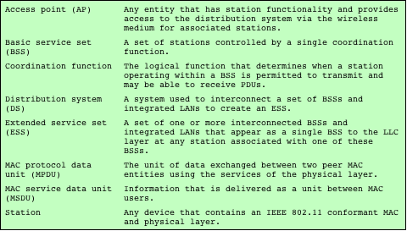
Table 7.1 IEEE 802.11 Terminology
Notes:
Table 7.1 briefly defines key terms used in the IEEE 802.11
standard.

Slide 20
Wi-Fi Alliance
The first 802.11 standard to gain broad industry acceptance was 802.11b
Wireless Ethernet Compatibility Alliance (WECA)
An industry consortium formed in 1999
Subsequently renamed the Wi-Fi (Wireless Fidelity) Alliance
Created a test suite to certify interoperability for 802.11 products
Wi-Fi
The term used for certified 802.11b products
Has been extended to 802.11g products
Wi-Fi5
A certification process for 802.11a products that was developed by the Wi-Fi Alliance
The Wi-Fi Alliance has developed certification procedures for IEEE 802.11 security standards
Referred to as Wi-Fi Protected Access (WPA)
Notes:
The first 802.11 standard to gain broad industry acceptance was 802.11b. Although
802.11b products are all based on the same standard, there is always a concern
whether products from different vendors will successfully interoperate. To meet
this concern, the Wireless Ethernet Compatibility Alliance (WECA), an industry
consortium, was formed in 1999. This organization, subsequently renamed the
Wi-Fi (Wireless Fidelity) Alliance, created a test suite to certify interoperability for
802.11b products. The term used for certified 802.11b products is Wi-Fi . Wi-Fi certification
has been extended to 802.11g products. The Wi-Fi Alliance has also developed
a certification process for 802.11a products, called Wi-Fi5 . The Wi-Fi Alliance
is concerned with a range of market areas for WLANs, including enterprise, home,
and hot spots.
More recently, the Wi-Fi Alliance has developed certification procedures for
IEEE 802.11 security standards, referred to as Wi-Fi Protected Access (WPA). The
most recent version of WPA, known as WPA2, incorporates all of the features of
the IEEE 802.11i WLAN security specification.

Slide 21
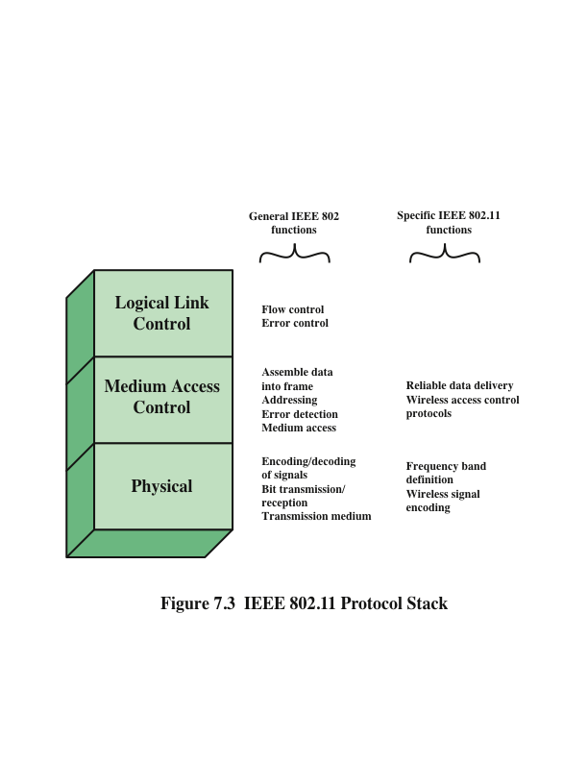
Notes:
Before proceeding, we need to briefly preview the IEEE 802 protocol architecture.
IEEE 802.11 standards are defined within the structure of a layered set of protocols.
This structure, used for all IEEE 802 standards, is illustrated in Figure 7.3.
Physical Layer
The lowest layer of the IEEE 802 reference model is the physical
layer, which includes such functions as encoding/decoding of signals and bit transmission/
reception. In addition, the physical layer includes a specification of the
transmission medium. In the case of IEEE 802.11, the physical layer also defines
frequency bands and antenna characteristics.
Media Access Control
All LANs consist of collections of devices that share the network’s
transmission capacity. Some means of controlling access to the transmission
medium is needed to provide an orderly and efficient use of that capacity. This is
the function of a media access control (MAC) layer. The MAC layer receives data
from a higher-layer protocol, typically the Logical Link Control (LLC) layer, in the
form of a block of data known as the MAC service data unit (MSDU). In general,
the MAC layer performs the following functions:
• On transmission, assemble data into a frame, known as a MAC protocol data
unit (MPDU) with address and error-detection fields.
• On reception, disassemble frame, and perform address recognition and error
detection.
• Govern access to the LAN transmission medium.
Logical Link Control
In most data-link control protocols, the data-link protocol
entity is responsible not only for detecting errors using the CRC, but for recovering
from those errors by retransmitting damaged frames. In the LAN protocol architecture,
these two functions are split between the MAC and LLC layers. The MAC
layer is responsible for detecting errors and discarding any frames that contain errors.
The LLC layer optionally keeps track of which frames have been successfully
received and retransmits unsuccessful frames.

Slide 22
IEEE 802 Protocol Architecture
Physical Layer
The lowest layer of the IEEE 802
Functions as encoding/decoding of signals and bit transmission/ reception
The physical layer includes a specification of the transmission medium. In the case of IEEE 802.11, the physical layer also defines frequency bands and antenna characteristics.

Slide 23
IEEE 802 Protocol Architecture
Media Access Control (MAC)
MAC Controlling access to the transmission.
The MAC layer receives data from a higher-layer protocol, typically the Logical Link Control (LLC) layer, in the form of a block of data known as the MAC service data unit (MSDU).
In general, the MAC layer performs the following functions:
On transmission, assemble data into a frame, known as a MAC protocol data unit (MPDU) with address and error-detection fields.
On reception, disassemble frame, and perform address recognition and error detection.
Govern access to the LAN transmission medium.

Slide 24
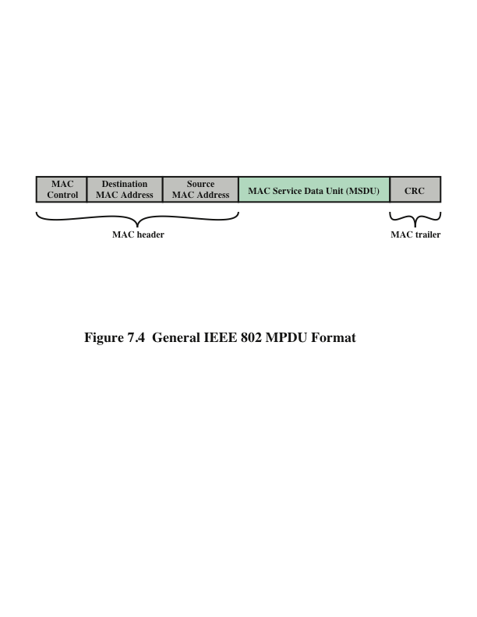
General IEEE 802 MPDU Format
• MAC Control: This field contains any protocol control information needed for the functioning of the MAC protocol. For example, a priority level could be indicated here.
• Destination MAC Address: The destination physical address on the LAN for this MPDU.
• Source MAC Address: The source physical address on the LAN for this MPDU.
• MAC Service Data Unit: The data from the next higher layer.
• CRC: The cyclic redundancy check field; also known as the Frame Check Sequence (FCS) field. This is an error-detecting code, such as that which is used in other data-link control protocols. The CRC is calculated based on the bits in the entire MPDU. The sender calculates the CRC and adds it to the frame. The receiver performs the same calculation on the incoming MPDU and compares that calculation to the CRC field in that incoming MPDU. If the two values don’t match, then one or more bits have been altered in transit.
Notes:
The exact format of the MPDU differs somewhat for the various MAC protocols
in use. In general, all of the MPDUs have a format similar to that of Figure 7.4.
The fields of this frame are as follows.
• MAC Control: This field contains any protocol control information needed
for the functioning of the MAC protocol. For example, a priority level could
be indicated here.
• Destination MAC Address: The destination physical address on the LAN for
this MPDU.
• Source MAC Address: The source physical address on the LAN for this
MPDU.
• MAC Service Data Unit: The data from the next higher layer.
• CRC: The cyclic redundancy check field; also known as the Frame Check
Sequence (FCS) field. This is an error-detecting code, such as that which is
used in other data-link control protocols. The CRC is calculated based on the
bits in the entire MPDU. The sender calculates the CRC and adds it to the
frame. The receiver performs the same calculation on the incoming MPDU
and compares that calculation to the CRC field in that incoming MPDU. If the
two values don’t match, then one or more bits have been altered in transit.
The fields preceding the MSDU field are referred to as the MAC header, and
the field following the MSDU field is referred to as the MAC trailer. The header
and trailer contain control information that accompany the data field and that are
used by the MAC protocol.

Slide 25
IEEE 802 Protocol Architecture
Logical Link Control (MAC)
In most data-link control protocols, the data-link protocol entity is responsible not only for detecting errors using the CRC, but for recovering from those errors by retransmitting damaged frames.
In the LAN protocol architecture, these two functions are split between the MAC and LLC layers.
The MAC layer is responsible for detecting errors and discarding any frames that contain errors.
The LLC layer optionally keeps track of which frames have been successfully received and retransmits unsuccessful frames.

Slide 26
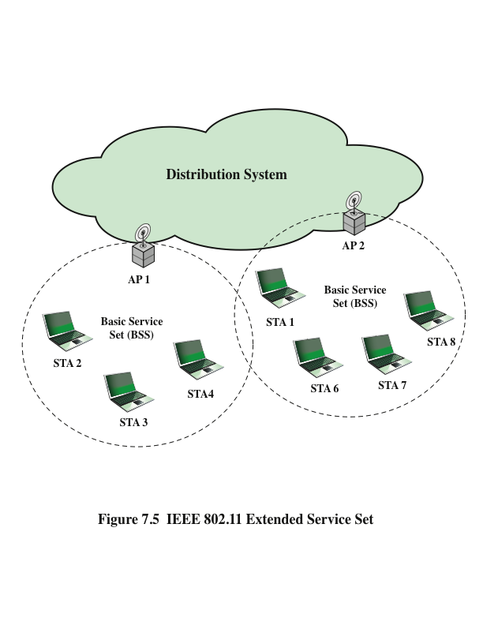
Basic Service Set (BSS)
– Smallest WLAN block
• Distribution System (DS)
– Connects BSS blocks
• Access Points (AP)
– Functions as a bridge or relay point
• Extended Service Set
(ESS)
– Two or more BSS
interconnected by a DS
Notes:
Figure 7.5 illustrates the model developed by the 802.11 working group. The smallest
building block of a wireless LAN is a basic service set (BSS) , which consists of
wireless stations executing the same MAC protocol and competing for access to the
same shared wireless medium. A BSS may be isolated, or it may connect to a backbone
distribution system (DS) through an access point (AP) . The AP functions as a
bridge and a relay point. In a BSS, client stations do not communicate directly with
one another. Rather, if one station in the BSS wants to communicate with another
station in the same BSS, the MAC frame is first sent from the originating station to
the AP and then from the AP to the destination station. Similarly, a MAC frame
from a station in the BSS to a remote station is sent from the local station to the AP
and then relayed by the AP over the DS on its way to the destination station. The
BSS generally corresponds to what is referred to as a cell in the literature. The DS
can be a switch, a wired network, or a wireless network.
When all the stations in the BSS are mobile stations that communicate directly
with one another (not using an AP), the BSS is called an independent BSS (IBSS) .
An IBSS is typically an ad hoc network. In an IBSS, the stations all communicate
directly, and no AP is involved.
A simple configuration is shown in Figure 7.5, in which each station belongs
to a single BSS; that is, each station is within wireless range only of other stations
within the same BSS. It is also possible for two BSSs to overlap geographically, so
that a single station could participate in more than one BSS. Furthermore, the association
between a station and a BSS is dynamic. Stations may turn off, come within
range, and go out of range.
An extended service set (ESS) consists of two or more basic service sets interconnected
by a distribution system. The extended service set appears as a single
logical LAN to the logical link control (LLC) level.

Slide 27
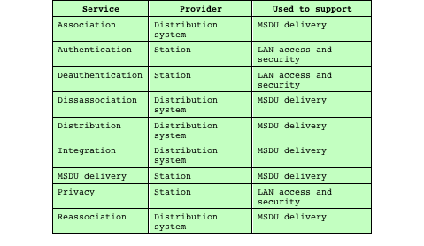
WLAN needs to
provide 9 services
to achieve
functional wired
equivalence
– Service
>Either a DS or Station
– Used to Support
>Security or Delivery
IEEE 802.11 Services
Notes:
IEEE 802.11 defines nine services that need to be provided by the wireless LAN to
achieve functionality equivalent to that which is inherent to wired LANs. Table 7.2
lists the services and indicates two ways of categorizing them.
1. The service provider can be either the station or the DS. Station services are
implemented in every 802.11 station, including AP stations. Distribution
services are provided between BSSs; these services may be implemented
in an AP or in another special-purpose device attached to the distribution
system.
2. Three of the services are used to control IEEE 802.11 LAN access and confidentiality.
Six of the services are used to support delivery of MSDUs between
stations. If the MSDU is too large to be transmitted in a single MPDU, it may
be fragmented and transmitted in a series of MPDUs.
Following the IEEE 802.11 document, we next discuss the services in an order
designed to clarify the operation of an IEEE 802.11 ESS network. MSDU delivery,
which is the basic service, already has been mentioned. Services related to security
are introduced in Section 7.4.

Slide 28
IEEE 802.11 Services
IEEE 802.11 defines nine services that need to be provided by the wireless LAN to achieve functionality equivalent to that which is inherent to wired LANs. Table in the previous slide lists the services and indicates two ways of categorizing them.
1. The service provider can be either the station or the DS. Station services are implemented in every 802.11 station, including AP stations. Distribution services are provided between BSSs; these services may be implemented in an AP or in another special-purpose device attached to the distribution system.
2. Three of the services are used to control IEEE 802.11 LAN access and confidentiality. Six of the services are used to support delivery of MSDUs between stations. If the MSDU is too large to be transmitted in a single MPDU, it may be fragmented and transmitted in a series of MPDUs.

Slide 29
Distribution of Messages Within a DS
Distribution
The primary service used by stations to exchange MPDUs when the MPDUs must traverse the DS to get from a station in one BSS to a station in another BSS
Integration
Enables transfer of data between a station on an IEEE 802.11 LAN and a station on an integrated IEEE 802.x LAN
Takes care of any address translation and media conversion logic required for the exchange of data
The two services involved with the distribution of messages within a DS are:
Notes:
The two services involved with the distribution
of messages within a DS are distribution and integration. Distribution is
the primary service used by stations to exchange MPDUs when the MPDUs must
traverse the DS to get from a station in one BSS to a station in another BSS. For
example, suppose a frame is to be sent from station 2 (STA 2) to station 7 (STA 7)
in Figure 7.5. The frame is sent from STA 2 to AP 1, which is the AP for this BSS.
The AP gives the frame to the DS, which has the job of directing the frame to the
AP associated with STA 7 in the target BSS. AP 2 receives the frame and forwards
it to STA 7. How the message is transported through the DS is beyond the scope of
the IEEE 802.11 standard.
If the two stations that are communicating are within the same BSS, then the
distribution service logically goes through the single AP of that BSS.
The integration service enables transfer of data between a station on an IEEE
802.11 LAN and a station on an integrated IEEE 802.x LAN. The term integrated
refers to a wired LAN that is physically connected to the DS and whose stations
may be logically connected to an IEEE 802.11 LAN via the integration service. The
integration service takes care of any address translation and media conversion logic
required for the exchange of data.

Slide 30
Association-Related Services
Transition types based on mobility:
No transition
A station of this type is either stationary or moves only within the direct communication range of the communicating stations of a single BSS
BSS transition
This is defined as a station movement from one BSS to another BSS within the same ESS
In this case, delivery of data to the station requires that the addressing capability be able to recognize the new location of the station
ESS transition
This is defined as a station movement from a BSS in one ESS to a BSS within another ESS
Maintenance of upper-layer connections supported by 802.11 cannot be guaranteed
Disruption of service is likely to occur
Notes:
The primary purpose of the MAC layer is to transfer
MSDUs between MAC entities; this purpose is fulfilled by the distribution service.
For that service to function, it requires information about stations within the ESS
that is provided by the association-related services. Before the distribution service
can deliver data to or accept data from a station, that station must be associated .
Before looking at the concept of association, we need to describe the concept of
mobility. The standard defines three transition types, based on mobility:
• No transition: A station of this type is either stationary or moves only
within the direct communication range of the communicating stations of a
single BSS.
• BSS transition: This is defined as a station movement from one BSS to another
BSS within the same ESS. In this case, delivery of data to the station
requires that the addressing capability be able to recognize the new location of
the station.
• ESS transition: This is defined as a station movement from a BSS in one ESS
to a BSS within another ESS. This case is supported only in the sense that
the station can move. Maintenance of upper-layer connections supported by
802.11 cannot be guaranteed. In fact, disruption of service is likely to occur.

Slide 31
Association-Related Services
To deliver a message within a DS, the distribution service needs to know the identity of the AP to which the message should be delivered in order for that message to reach the destination station
Three services relate to a station maintaining an association with the AP within its current BSS:
Association
Establishes an initial association between a station and an AP
Reassociation
Enables an established association to be transferred from one AP to another, allowing a mobile station to move from one BSS to another
Disassociation
A notification from either a station or an AP that an existing association is terminated
Notes:
To deliver a message within a DS, the distribution service needs to know
where the destination station is located. Specifically, the DS needs to know the
identity of the AP to which the message should be delivered in order for that message
to reach the destination station. To meet this requirement, a station must
maintain an association with the AP within its current BSS. Three services relate
to this requirement:
• Association: Establishes an initial association between a station and an AP.
Before a station can transmit or receive frames on a wireless LAN, its identity
and address must be known. For this purpose, a station must establish an association
with an AP within a particular BSS. The AP can then communicate
this information to other APs within the ESS to facilitate routing and delivery
of addressed frames.
• Reassociation: Enables an established association to be transferred from one
AP to another, allowing a mobile station to move from one BSS to another.
• Disassociation: A notification from either a station or an AP that an existing
association is terminated. A station should give this notification before leaving
an ESS or shutting down. However, the MAC management facility protects
itself against stations that disappear without notification.

Slide 32
IEEE 802.11I Wireless LAN Security
There is an increased need for robust security services and mechanisms for wireless LANs
Wired Equivalent Privacy (WEP)
The privacy portion of the 802.11 standard
Contained major weaknesses
Wi-Fi Protected Access (WPA)
A set of security mechanisms that eliminates most 802.11 security issues
Based on the current state of the 802.11i standard
Robust Security Network (RSN)
Final form of the 802.11i standard
Complex
Notes:
There are two characteristics of a wired LAN that are not inherent in a wireless
LAN.
1. In order to transmit over a wired LAN, a station must be physically connected
to the LAN. On the other hand, with a wireless LAN, any station within radio
range of the other devices on the LAN can transmit. In a sense, there is a form
of authentication with a wired LAN in that it requires some positive and presumably
observable action to connect a station to a wired LAN.
2. Similarly, in order to receive a transmission from a station that is part of a
wired LAN, the receiving station also must be attached to the wired LAN.
On the other hand, with a wireless LAN, any station within radio range can
receive. Thus, a wired LAN provides a degree of privacy, limiting reception of
data to stations connected to the LAN.
These differences between wired and wireless LANs suggest the increased
need for robust security services and mechanisms for wireless LANs. The original
802.11 specification included a set of security features for privacy and authentication
that were quite weak. For privacy, 802.11 defined the Wired Equivalent
Privacy (WEP) algorithm. The privacy portion of the 802.11 standard contained
major weaknesses. Subsequent to the development of WEP, the 802.11i task
group has developed a set of capabilities to address the WLAN security issues.
In order to accelerate the introduction of strong security into WLANs, the Wi-Fi
Alliance promulgated Wi-Fi Protected Access (WPA) as a Wi-Fi standard. WPA
is a set of security mechanisms that eliminates most 802.11 security issues and
was based on the current state of the 802.11i standard. The final form of the
802.11i standard is referred to as Robust Security Network (RSN) . The Wi-Fi
Alliance certifies vendors in compliance with the full 802.11i specification under
the WPA2 program.
The RSN specification is quite complex, and occupies 145 pages of the 2012
IEEE 802.11 standard. In this section, we provide an overview.

Slide 33
WEP Problems
No centralized key management
– Manual key distribution > Difficult to change keys
Single set of Keys shared by all > Frequent changes necessary
No mutual authentication
Initialization Vector (IV) value is too short. Not protected from reuse.
Weak integrity check.
Directly uses master key
No protection against replay
Bottom line:
Weakness: Key Management
and Key Size

Slide 34
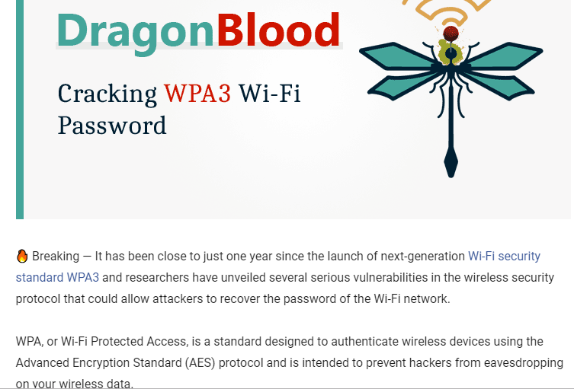
Recent News
https://thehackernews.com/2019/04/wpa3-hack-wifi-password.html

Slide 35
IEEE 802.11i RSN
The 802.11i RSN security specification defines the following services.
Authentication: A protocol is used to define an exchange between a user and an AS that provides mutual authentication and generates temporary keys to be used between the client and the AP over the wireless link.
Access control: This function enforces the use of the authentication function, routes the messages properly, and facilitates key exchange. It can work with a variety of authentication protocols.
Privacy with message integrity: MAC-level data (e.g., an LLC PDU) are encrypted along with a message integrity code that ensures that the data have not been altered.

Slide 36
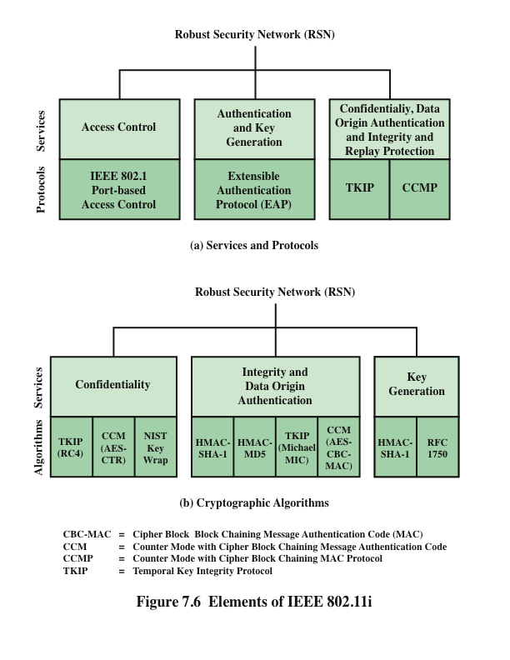
Notes:
The 802.11i RSN security specification defines the following services.
• Authentication: A protocol is used to define an exchange between a user and
an AS that provides mutual authentication and generates temporary keys to
be used between the client and the AP over the wireless link.
• Access control: This function enforces the use of the authentication function,
routes the messages properly, and facilitates key exchange. It can work with a
variety of authentication protocols.
• Privacy with message integrity: MAC-level data (e.g., an LLC PDU) are encrypted
along with a message integrity code that ensures that the data have
not been altered.
Figure 7.6a indicates the security protocols used to support these services,
while Figure 7.6b lists the cryptographic algorithms used for these services.

Slide 37
IEEE 802.11i Phases of Operation
The operation of an IEEE 802.11i RSN can be broken down into five distinct phases of operation. The exact nature of the phases will depend on the configuration and the end points of the communication. Possibilities include (see Figure 7.5):
1. Two wireless stations in the same BSS communicating via the access point (AP) for that BSS.
2. Two wireless stations (STAs) in the same ad hoc IBSS communicating directly with each other.
3. Two wireless stations in different BSSs communicating via their respective APs across a distribution system.
4. A wireless station communicating with an end station on a wired network via its AP and the distribution system.

Slide 38
IEEE 802.11i Phases of Operation
IEEE 802.11i security is concerned only with secure communication between the STA and its AP. In case 1 in the preceding list, secure communication is assured
If each STA establishes secure communications with the AP. Case 2 is similar, with the AP functionality residing in the STA.
For case 3, security is not provided across the distribution system at the level of IEEE 802.11, but only within each BSS. End-to-end security (if required) must be provided at a higher layer.
Similarly, in case 4, security is only provided between the STA and its AP.

Slide 39
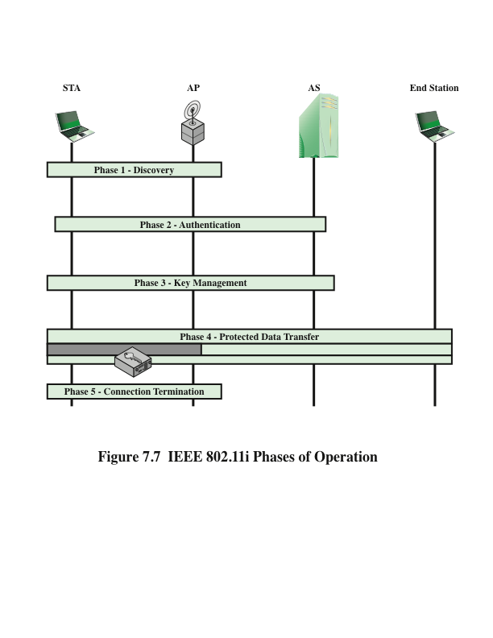
Notes:
The operation of an IEEE 802.11i RSN can be broken down into five distinct phases
of operation. The exact nature of the phases will depend on the configuration and
the end points of the communication. Possibilities include (see Figure 7.5):
1. Two wireless stations in the same BSS communicating via the access point
(AP) for that BSS.
2. Two wireless stations (STAs) in the same ad hoc IBSS communicating directly
with each other.
3. Two wireless stations in different BSSs communicating via their respective
APs across a distribution system.
4. A wireless station communicating with an end station on a wired network via
its AP and the distribution system.
IEEE 802.11i security is concerned only with secure communication between
the STA and its AP. In case 1 in the preceding list, secure communication is assured
if each STA establishes secure communications with the AP. Case 2 is similar, with
the AP functionality residing in the STA. For case 3, security is not provided across
the distribution system at the level of IEEE 802.11, but only within each BSS. Endto-
end security (if required) must be provided at a higher layer. Similarly, in case 4,
security is only provided between the STA and its AP.
With these considerations in mind, Figure 7.7 depicts the five phases of operation
for an RSN and maps them to the network components involved. One new
component is the authentication server (AS). The rectangles indicate the exchange
of sequences of MPDUs. The five phases are defined as follows.
• Discovery: An AP uses messages called Beacons and Probe Responses to advertise
its IEEE 802.11i security policy. The STA uses these to identify an AP
for a WLAN with which it wishes to communicate. The STA associates with
the AP, which it uses to select the cipher suite and authentication mechanism
when the Beacons and Probe Responses present a choice.
• Authentication: During this phase, the STA and AS prove their identities to
each other. The AP blocks non-authentication traffic between the STA and
AS until the authentication transaction is successful. The AP does not participate
in the authentication transaction other than forwarding traffic between
the STA and AS.
• Key generation and distribution: The AP and the STA perform several operations
that cause cryptographic keys to be generated and placed on the AP and
the STA. Frames are exchanged between the AP and STA only.
• Protected data transfer: Frames are exchanged between the STA and the end
station through the AP. As denoted by the shading and the encryption module
icon, secure data transfer occurs between the STA and the AP only; security is
not provided end-to-end.
• Connection termination: The AP and STA exchange frames. During this
phase, the secure connection is torn down and the connection is restored to
the original state.

Slide 40
IEEE 802.11 Phases Of Operation
Figure 7.7 depicts the five phases of operation for an RSN and maps them to the network components involved: Rectangles indicate the exchange of sequences of MPDUs. The five phases are defined as follows.
Discovery: An AP uses messages called Beacons and Probe Responses to advertise its IEEE 802.11i security policy. The STA uses these to identify an AP for a WLAN with which it wishes to communicate. The STA associates with the AP, which it uses to select the cipher suite and authentication mechanism when the Beacons and Probe Responses present a choice.

Slide 41
IEEE 802.11 Phases Of Operation
Authentication: During this phase, the STA and AS prove their identities to each other. The AP blocks non-authentication traffic between the STA and AS until the authentication transaction is successful. The AP does not participate in the authentication transaction other than forwarding traffic between the STA and AS.
Key generation and distribution: The AP and the STA perform several operations that cause cryptographic keys to be generated and placed on the AP and the STA. Frames are exchanged between the AP and STA only

Slide 42
IEEE 802.11 Phases Of Operation
Protected data transfer: Frames are exchanged between the STA and the end station through the AP. As denoted by the shading and the encryption module icon, secure data transfer occurs between the STA and the AP only; security is not provided end-to-end.
Connection termination: The AP and STA exchange frames. During this phase, the secure connection is torn down and the connection is restored to the original state.

Slide 43
802.11i Discovery Phase
Notes:
We now look in more detail at the RSN phases of operation, beginning with the
discovery phase, which is illustrated in the upper portion of Figure 7.8. The purpose
of this phase is for an STA and an AP to recognize each other, agree on a set
of security capabilities, and establish an association for future communication using
those security capabilities.
Security Capabilities
During this phase, the STA and AP decide on specific techniques
in the following areas:
• Confidentiality and MPDU integrity protocols for protecting unicast traffic
(traffic only between this STA and AP)
• Authentication method
• Cryptography key management approach
Confidentiality and integrity protocols for protecting multicast/broadcast traffic
are dictated by the AP, since all STAs in a multicast group must use the same
protocols and ciphers. The specification of a protocol, along with the chosen key
length (if variable) is known as a cipher suite . The options for the confidentiality and
integrity cipher suite are
• WEP, with either a 40-bit or 104-bit key, which allows backward compatibility
with older IEEE 802.11 implementations
• TKIP
• CCMP
• Vendor-specific methods
The other negotiable suite is the authentication and key management (AKM)
suite, which defines (1) the means by which the AP and STA perform mutual authentication
and (2) the means for deriving a root key from which other keys may
be generated. The possible AKM suites are
• IEEE 802.1X
• Pre-shared key (no explicit authentication takes place and mutual authentication
is implied if the STA and AP share a unique secret key)
• Vendor-specific methods
The discovery phase consists of three exchanges.
• Network and security capability discovery: During this exchange, STAs discover
the existence of a network with which to communicate. The AP either
periodically broadcasts its security capabilities (not shown in figure), indicated
by RSN IE (Robust Security Network Information Element), in a specific
channel through the Beacon frame; or responds to a station’s Probe Request
through a Probe Response frame. A wireless station may discover available
access points and corresponding security capabilities by either passively monitoring
the Beacon frames or actively probing every channel.
• Open system authentication: The purpose of this frame sequence, which
provides no security, is simply to maintain backward compatibility with the
IEEE 802.11 state machine, as implemented in existing IEEE 802.11 hardware.
In essence, the two devices (STA and AP) simply exchange identifiers.
• Association: The purpose of this stage is to agree on a set of security capabilities
to be used. The STA then sends an Association Request frame to the AP.
In this frame, the STA specifies one set of matching capabilities (one
authentication and key management suite, one pairwise cipher suite, and one
group-key cipher suite) from among those advertised by the AP. If there
is no match in capabilities between the AP and the STA, the AP refuses
the Association Request. The STA blocks it too, in case it has associated
with a rogue AP or someone is inserting frames illicitly on its channel. As
shown in Figure 7.8, the IEEE 802.1X controlled ports are blocked, and no
user traffic goes beyond the AP. The concept of blocked ports is explained
subsequently.
As was mentioned, the authentication phase enables mutual authentication between
an STA and an authentication server (AS) located in the DS. Authentication
is designed to allow only authorized stations to use the network and to provide the
STA with assurance that it is communicating with a legitimate network.

Slide 44
802.11i Discovery Phase

Slide 45
802.11i Discovery Phase

Slide 46
IEEE 802.1X Access Control Approach
802.11i Authentication Phase
Port-Based Network Access Control
The authentication protocol that is used, the Extensible Authentication Protocol (EAP), is defined in the IEEE 802.1X standard
802.1X uses:
Controlled ports
Allows the exchange of PDUs between a supplicant and other systems on the LAN only if the current state of the supplicant authorizes such an exchange
Uncontrolled ports
Allows the exchange of PDUs between the supplicant and the other AS, regardless of the authentication state of the supplicant
Notes:
IEEE 802.11i makes use of another standard
that was designed to provide access control functions for LANs. The standard
is IEEE 802.1X, Port-Based Network Access Control. The authentication protocol
that is used, the Extensible Authentication Protocol (EAP), is defined in the
IEEE 802.1X standard. IEEE 802.1X uses the terms supplicant , authenticator , and
authentication server (AS). In the context of an 802.11 WLAN, the first two terms
correspond to the wireless station and the AP. The AS is typically a separate device
on the wired side of the network (i.e., accessible over the DS) but could also reside
directly on the authenticator.
Before a supplicant is authenticated by the AS using an authentication protocol,
the authenticator only passes control or authentication messages between the
supplicant and the AS; the 802.1X control channel is unblocked, but the 802.11 data
channel is blocked. Once a supplicant is authenticated and keys are provided, the
authenticator can forward data from the supplicant, subject to predefined access
control limitations for the supplicant to the network. Under these circumstances,
the data channel is unblocked.
As indicated in Figure 5.5, 802.1X uses the concepts of controlled and uncontrolled
ports. Ports are logical entities defined within the authenticator and refer to
physical network connections. For a WLAN, the authenticator (the AP) may have
only two physical ports: one connecting to the DS and one for wireless communication
within its BSS. Each logical port is mapped to one of these two physical ports.
An uncontrolled port allows the exchange of PDUs between the supplicant and the
other AS, regardless of the authentication state of the supplicant. A controlled port
allows the exchange of PDUs between a supplicant and other systems on the LAN
only if the current state of the supplicant authorizes such an exchange. IEEE 802.1X
is covered in more detail in Chapter 5.
The 802.1X framework, with an upper-layer authentication protocol, fits
nicely with a BSS architecture that includes a number of wireless stations and an AP.
However, for an IBSS, there is no AP. For an IBSS, 802.11i provides a more
complex solution that, in essence, involves pairwise authentication between stations
on the IBSS.

Slide 47
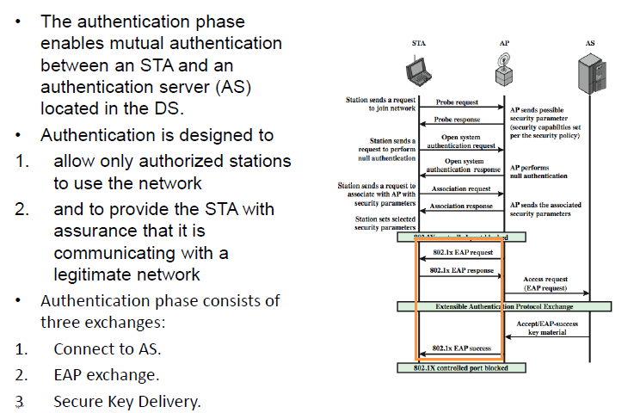
802.11i Authentication Phase

Slide 48
802.11i Authentication Phase

Slide 49
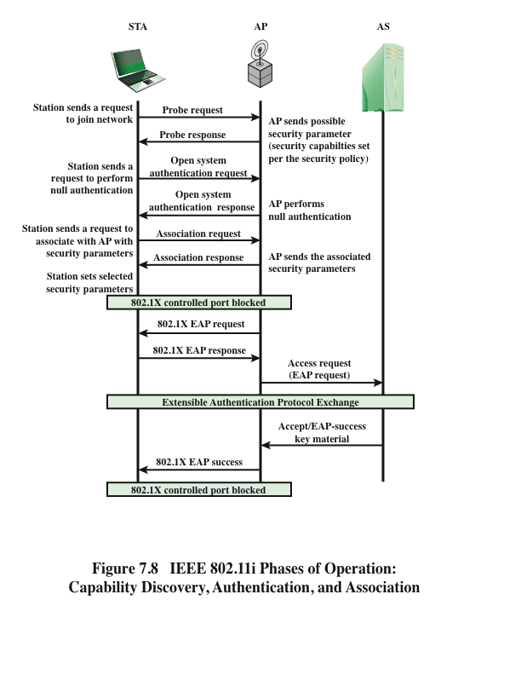
Notes:
The lower part of Figure 7.8 shows the MPDU exchange dictated
by IEEE 802.11 for the authentication phase. We can think of authentication
phase as consisting of the following three phases.
• Connect to AS: The STA sends a request to its AP (the one with which it has
an association) for connection to the AS. The AP acknowledges this request
and sends an access request to the AS.
• EAP exchange: This exchange authenticates the STA and AS to each other. A
number of alternative exchanges are possible, as explained subsequently.
• Secure key delivery: Once authentication is established, the AS generates
a master session key (MSK), also known as the Authentication,
Authorization, and Accounting (AAA) key and sends it to the STA. As
explained subsequently, all the cryptographic keys needed by the STA
for secure communication with its AP are generated from this MSK.
IEEE 802.11i does not prescribe a method for secure delivery of the MSK
but relies on EAP for this. Whatever method is used, it involves the transmission
of an MPDU containing an encrypted MSK from the AS, via
the AP, to the AS.
As mentioned, there are a number of possible EAP exchanges that
can be used during the authentication phase. Typically, the message flow between
STA and AP employs the EAP over LAN (EAPOL) protocol, and the message
flow between the AP and AS uses the Remote Authentication Dial In User Service
(RADIUS) protocol, although other options are available for both STA-to-AP and
AP-to-AS exchanges. [FRAN07] provides the following summary of the authentication
exchange using EAPOL and RADIUS.
1. The EAP exchange begins with the AP issuing an EAP-Request/Identity
frame to the STA.
2. The STA replies with an EAP-Response/Identity frame, which the AP receives
over the uncontrolled port. The packet is then encapsulated in RADIUS over
EAP and passed on to the RADIUS server as a RADIUS-Access-Request
packet.
3. The AAA server replies with a RADIUS-Access-Challenge packet, which is
passed on to the STA as an EAP-Request. This request is of the appropriate
authentication type and contains relevant challenge information.
4. The STA formulates an EAP-Response message and sends it to the AS. The
response is translated by the AP into a Radius-Access-Request with the response
to the challenge as a data field. Steps 3 and 4 may be repeated multiple
times, depending on the EAP method in use. For TLS tunneling methods, it is
common for authentication to require 10 to 20 round trips.
5. The AAA server grants access with a Radius-Access-Accept packet. The AP
issues an EAP-Success frame. (Some protocols require confirmation of the
EAP success inside the TLS tunnel for authenticity validation.) The controlled
port is authorized, and the user may begin to access the network.
Note from Figure 7.8 that the AP controlled port is still blocked to general
user traffic. Although the authentication is successful, the ports remain blocked
until the temporal keys are installed in the STA and AP, which occurs during the
4-Way Handshake.

Slide 50
802.11i Key Management Phase

Slide 51
802.11i Key Management Phase

Slide 52
802.11i Key Management Phase
The three parts of the PTK are as follows.
1. EAP Over LAN (EAPOL) Key Confirmation Key (EAPOL-KCK): Supports the integrity and data origin authenticity of STA-to-AP control frames . It also performs an access control function.
2. EAPOL Key Encryption Key (EAPOL-KEK): Protects the confidentiality of keys and other control frames.
3. Temporal Key (TK): Provides the actual protection for user traffic.

Slide 53
802.11i Key Management Phases
GROUP KEYS Group keys are
used for multicast communication in which one STA sends MPDU’s to multiple STAs.
Group Master Key (GMK)
The GMK is a key-generating key
used with other inputs to derive the Group Temporal Key (GTK).
The GTK is distributed securely
using the pairwise keys that are
already established. The GTK is
changed every time a device
leaves the network.

Slide 54
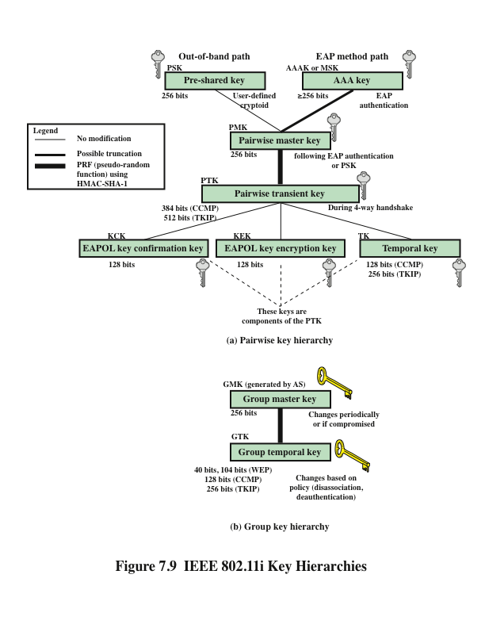
Notes:
During the key management phase, a variety of cryptographic keys are generated
and distributed to STAs. There are two types of keys: pairwise keys used for communication
between an STA and an AP and group keys used for multicast communication.
Figure 7.9, based on [FRAN07], shows the two key hierarchies.

Slide 55
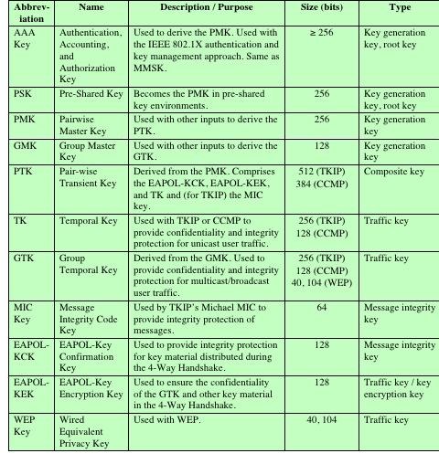
IEEE 802.11i
Keys for Data Confidentiality
and
Integrity Protocols
(Table can be found on page 229 in textbook)
Notes:
Table 7.3 defines the individual keys.

Slide 56
Pairwise Keys
Used for communication between a pair of devices, typically between a STA and an AP
These keys form a hierarchy beginning with a master key from which other keys are derived dynamically and used for a limited period of time
Pre-shared key (PSK)
A secret key shared by the AP and a STA and installed in some fashion outside the scope of IEEE 802.11i
Master session key (MSK)
Also known as the AAAK, and is generated using the IEEE 802.1X protocol during the authentication phase
Pairwise master key (PMK)
Derived from the master key
If a PSK is used, then the PSK is used as the PMK; if a MSK is used, then the PMK is derived from the MSK by truncation
Pairwise transient key (PTK)
Consists of three keys to be used for communication between a STA and AP after they have been mutually authenticated
Using the STA and AP addresses in the generation of the PTK provides protection against session hijacking and impersonation; using nonces provides additional random keying material
Notes:
Pairwise keys are used for communication between a pair of devices,
typically between an STA and an AP. These keys form a hierarchy beginning
with a master key from which other keys are derived dynamically and used for a
limited period of time.
At the top level of the hierarchy are two possibilities. A pre-shared key (PSK)
is a secret key shared by the AP and a STA and installed in some fashion outside
the scope of IEEE 802.11i. The other alternative is the master session key (MSK) ,
also known as the AAAK, which is generated using the IEEE 802.1X protocol during
the authentication phase, as described previously. The actual method of key
generation depends on the details of the authentication protocol used. In either case
(PSK or MSK), there is a unique key shared by the AP with each STA with which
it communicates. All the other keys derived from this master key are also unique
between an AP and an STA. Thus, each STA, at any time, has one set of keys, as
depicted in the hierarchy of Figure 7.9a, while the AP has one set of such keys for
each of its STAs.
The pairwise master key (PMK) is derived from the master key. If a PSK is
used, then the PSK is used as the PMK; if a MSK is used, then the PMK is derived
from the MSK by truncation (if necessary). By the end of the authentication phase,
marked by the 802.1X EAP Success message (Figure 7.8), both the AP and the
STA have a copy of their shared PMK.
The PMK is used to generate the pairwise transient key (PTK) , which in fact
consists of three keys to be used for communication between an STA and AP after
they have been mutually authenticated. To derive the PTK, the HMAC-SHA-1
function is applied to the PMK, the MAC addresses of the STA and AP, and nonces
generated when needed. Using the STA and AP addresses in the generation of the
PTK provides protection against session hijacking and impersonation; using nonces
provides additional random keying material.

Slide 57
PTK Parts
The three parts of the PTK are:
EAP Over LAN (EAPOL) Key Confirmation Key (EAPOL-KCK)
Supports the integrity and data origin authenticity of STA-to-AP control frames during operational setup of an RSN
It also performs an access control function: proof-of-possession of the PMK
An entity that possesses the PMK is authorized to use the link
EAPOL Key Encryption Key (EAPOL-KEK)
Protects the confidentiality of keys and other data during some RSN association procedures
Temporal Key (TK)
Provides the actual protection for user traffic
Notes:
The three parts of the PTK are as follows.
EAP Over LAN (EAPOL) Key Confirmation Key (EAPOL-KCK): Supports
the integrity and data origin authenticity of STA-to-AP control frames during
operational setup of an RSN. It also performs an access control function:
proof-of-possession of the PMK. An entity that possesses the PMK is authorized
to use the link.
• EAPOL Key Encryption Key (EAPOL-KEK): Protects the confidentiality of
keys and other data during some RSN association procedures.
• Temporal Key (TK): Provides the actual protection for user traffic.

Slide 58
Group Keys
Group keys are used for multicast communication in which one STA sends MPDUs to multiple STAs
Group master key (GMK)
Key-generating key used with other inputs to derive the GTK
Group temporal key (GTK)
Generated by the AP and transmitted to its associated STAs
IEEE 802.11i requires that its value is computationally indistinguishable from random
Distributed securely using the pairwise keys that are already established
Is changed every time a device leaves the network
Notes:
Group keys are used for multicast communication in which one STA
sends MPDUs to multiple STAs. At the top level of the group key hierarchy is the
group master key (GMK) . The GMK is a key-generating key used with other inputs
to derive the group temporal key (GTK) . Unlike the PTK, which is generated using
material from both AP and STA, the GTK is generated by the AP and transmitted
to its associated STAs. Exactly how this GTK is generated is undefined. IEEE
802.11i, however, requires that its value is computationally indistinguishable from
random. The GTK is distributed securely using the pairwise keys that are already
established. The GTK is changed every time a device leaves the network.

Slide 59
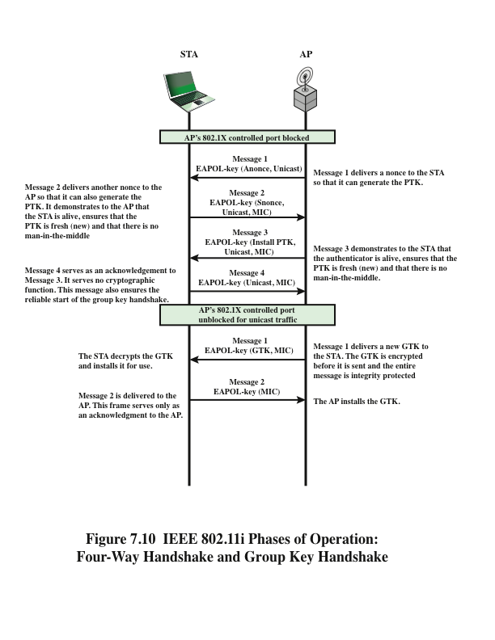
Notes:
The upper part of Figure 7.10 shows the MPDU
exchange for distributing pairwise keys. This exchange is known as the 4-way handshake .
The STA and AP use this handshake to confirm the existence of the PMK,
verify the selection of the cipher suite, and derive a fresh PTK for the following data
session.

Slide 60
Protected Data Transfer Phase
IEEE 802.11i defines two schemes for protecting data transmitted in 802.11 MPDUs:
Temporal Key Integrity Protocol (TKIP)
Designed to require only software changes to devices that are implemented with WEP
Counter Mode-CBC MAC Protocol (CCMP)
Intended for newer IEEE 802.11 devices that are equipped with the hardware to support this scheme
Provides two services:
Message integrity
Data confidentiality
Notes:
IEEE 802.11i defines two schemes for protecting data transmitted in 802.11 MPDUs:
the Temporal Key Integrity Protocol (TKIP), and the Counter Mode-CBC MAC
Protocol (CCMP).
TKIP is designed to require only software changes to devices that are implemented
with the older wireless LAN security approach called Wired Equivalent
Privacy (WEP). TKIP provides two services:
• Message integrity: TKIP adds a message integrity code (MIC) to the 802.11
MAC frame after the data field. The MIC is generated by an algorithm, called
Michael, that computes a 64-bit value using as input the source and destination
MAC address values and the Data field, plus key material.
• Data confidentiality: Data confidentiality is provided by encrypting the
MPDU plus MIC value using RC4.
The 256-bit TK (Figure 7.9) is employed as follows. Two 64-bit keys are used
with the Michael message digest algorithm to produce a message integrity code.
One key is used to protect STA-to-AP messages, and the other key is used to protect
AP-to-STA messages. The remaining 128 bits are truncated to generate the
RC4 key used to encrypt the transmitted data.
For additional protection, a monotonically increasing TKIP sequence counter
(TSC) is assigned to each frame. The TSC serves two purposes. First, the TSC is
included with each MPDU and is protected by the MIC to protect against replay
attacks. Second, the TSC is combined with the session TK to produce a dynamic encryption
key that changes with each transmitted MPDU, thus making cryptanalysis
more difficult.
CCMP is intended for newer IEEE 802.11 devices that are equipped with
the hardware to support this scheme. As with TKIP, CCMP provides two services:
• Message integrity: CCMP uses the cipher block chaining message authentication
code (CBC-MAC), described in Chapter 3.
• Data confidentiality: CCMP uses the CTR block cipher mode of operation
with AES for encryption. CTR is described in Chapter 2.
The same 128-bit AES key is used for both integrity and confidentiality.
The scheme uses a 48-bit packet number to construct a nonce to prevent replay
attacks.

Slide 61
Protected Data Transfer Phase
TKIP:
Message integrity: TKIP adds a message integrity code (MIC) to the 802.11 MAC frame after the data field. The MIC is generated by an algorithm, called Michael, that computes a 64-bit value using as input the source and destination MAC address values and the Data field, plus key material.
Data confidentiality: Data confidentiality is provided by encrypting the MPDU plus MIC value using RC4.
CCMP
Message integrity : Use the Cipher Block Chaining Message Authentication Code (CBC-MAC).
Data Confidentiality : The use of 128-bit AES encryption.

Slide 62
IEEE 802.11i Pseudorandom Function (PRF)
Used at a number of places in the IEEE 802.11i scheme (to generate nonces, to expand pairwise keys, to generate the GTK)
Best security practice dictates that different pseudorandom number streams be used for these different purposes
Built on the use of HMAC-SHA-1 to generate a pseudorandom bit stream
Notes:
At a number of places in the IEEE 802.11i scheme, a pseudorandom function (PRF)
is used. For example, it is used to generate nonces, to expand pairwise keys, and
to generate the GTK. Best security practice dictates that different pseudorandom
number streams be used for these different purposes. However, for implementation
efficiency, we would like to rely on a single pseudorandom number generator
function.
The PRF is built on the use of HMAC-SHA-1 to generate a pseudorandom
bit stream. Recall that HMAC-SHA-1 takes a message (block of data) and a key of
length at least 160 bits and produces a 160-bit hash value. SHA-1 has the property
that the change of a single bit of the input produces a new hash value with no apparent
connection to the preceding hash value. This property is the basis for pseudorandom
number generation.

Slide 63
Summary
IEEE 802.11i wireless LAN security
IEEE 802.11i services
IEEE 802.11i phases of operation
Discovery phase
Authentication phase
Key management phase
Protected data transfer phase
The IEEE 802.11i pseudorandom function
Wireless network security
Network threats
Security measures
Mobile device security
Security threats
Security strategy
IEEE 802.11 wireless LAN overview
Wi-Fi Alliance
IEEE 802 protocol architecture
IEEE 802.11 network components and architectural model
IEEE 802.11 services
Notes:
Chapter 7 summary.

